Slide 1
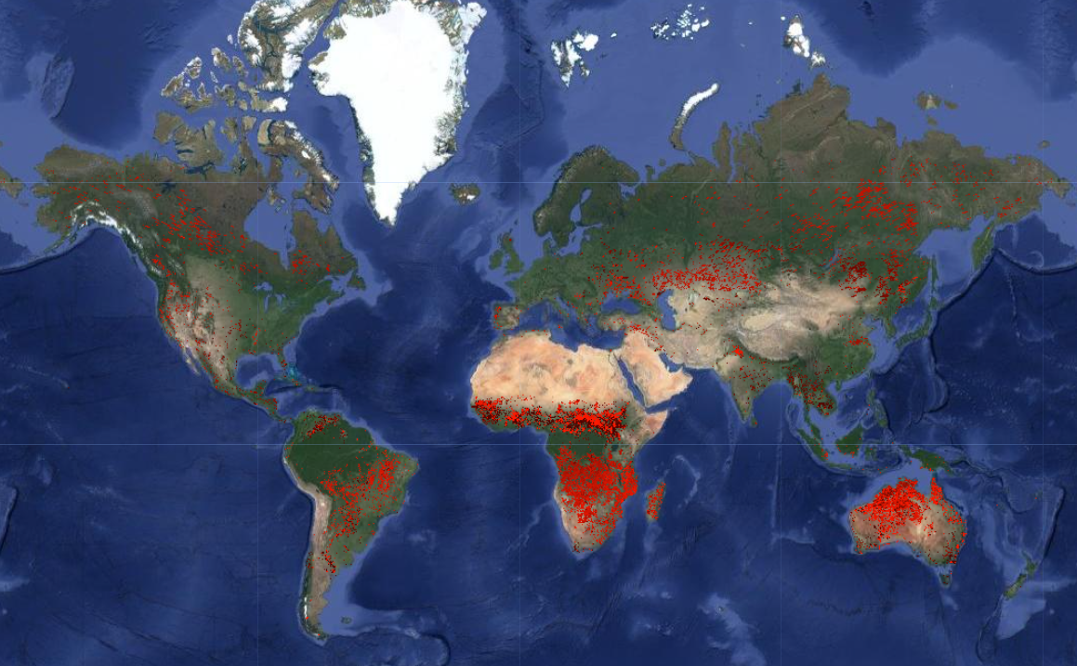
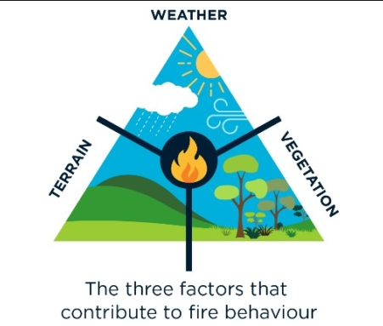
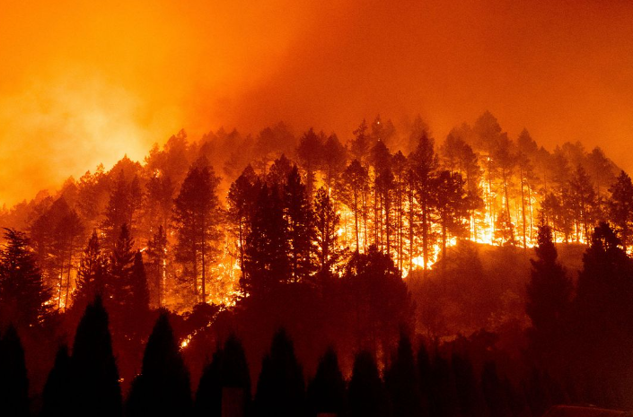

Analysis Of Factors Affecting Wildfire Distribution
MCD64A1.061 MODIS Burned Area Monthly Global 500m
Geoinformatics Project
2023-2024

Slide 2

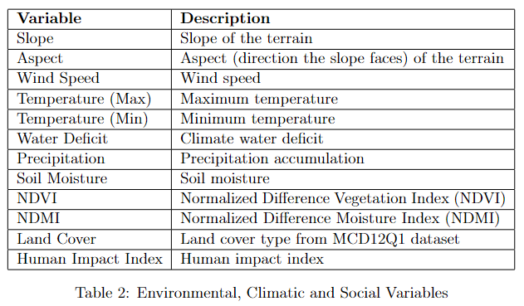

Input Products
GEE Collections
External Products
Selected Variables
Hexagon Map Grid
Shapefiles
- 7 products for each continent :
Europe
Africa
Asia
North America
South America
Australia
Oceania
- Each uploaded as asset on GEE

Slide 3


Input Products
Hexagon Map Grid
- Derived from QGIS
- 300 km horizontal and vertical spacing
- Representing geographic areas at a broader scale
- Uploaded in GEE as asset

Slide 4
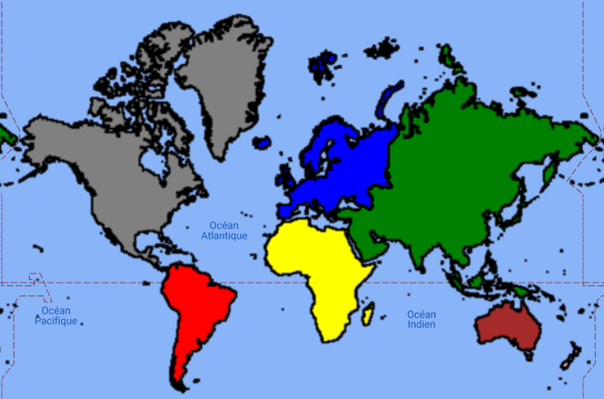
Data Preprocessing
Clipping the Area of Interest in continents
Reasons
Avoiding the finite amount of RAM available for computation.
Excluding the pixels representing oceans and seas from the processing step.

Slide 5
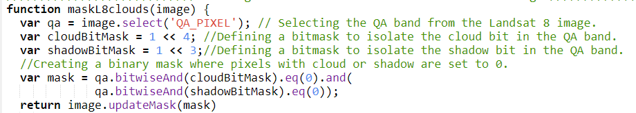
Data Preprocessing
Removing Cloud Cover and Shadows from Landsat images
Reasons
Computing the vegetation indexes (NDVI and NDMI)
Their presence can introduce noise and errors in the results.
Process:
Using the QA band from the Landsat images.
Defining bitmasks to isolate the cloud and shadow bit in the QA-band.

Slide 6
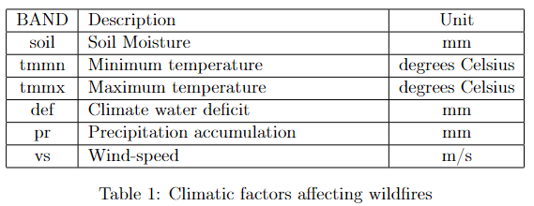
Data Preprocessing
Aggregation of variables
Environmental and Climatic variables
Wind Speed
Max Temperature
Min Temperature
Water Deficit
Precipitation
Soil Moisture
Preprocessing
Filtering to a time-range of 13 years (2010-2023)
Aggregation using median values
.median() function: calculates the median value for each pixel
Collection
TerraClimate: Monthly Climate and Climatic Water Balance for Global Terrestrial Surfaces, University of Idaho

Slide 7
Data Preprocessing
Aggregation of variables
Preprocessing
Vegetation indices and Land Cover
NDVI
NDMI
Land Cover
Filtering to a time-range of 13 years (2010-2023)
Single composite image representing the median values for each pixel
.median() function is applied to the processed image collection of Landsat
Collections
USGS Landsat 8 Collection 2 Tier 1 TOA Reflectance
MCD12Q1.061 MODIS Land Cover Type Yearly Global 500m
No Preprocessing
Represented by categorical values
Taking the true values rather than aggregating them.
Reprojected to match the CRS of other products.

Slide 8
Data Preprocessing
Aggregation of variables
Topographic variables
Slope
Aspect
No Preprocessing
Collection
Unit : meters
Data and are static over short periods, no aggregation was applied
NASA SRTM Digital Elevation 30m

Slide 9
Data Preprocessing
Aggregation of variables
Social variables
Human Impact Index
Preprocessing
Collection
Aggregating to the mean values
The mean value represents the central tendency of the distribution of the human impact across the area of each point.
Human Impact Index (HII) by Wildlife Conservation Society

Slide 10
Final Product
Selected Variables
Predictor Image
Combines all the preprocessed variables.
Variables are considered as bands of this image.
Serves as an input for wildfire risk assessment.
Used in the process of sampling to generate training points feeding the algorithms.

Slide 11
Approaches
Advantages
First Approach
Second Approach
Advantages
Less computational time.
Creating a binary mask of burned and non-burned pixels
Performing stratified sampling over an area
Creating pure fires binary mask
Creating an area image and performing zonal statistics
Extracting sample points over hexagons
Handling raster data easier.
Modified for usage in smaller areas of interest.
Simplifying the sampling process.

Slide 12
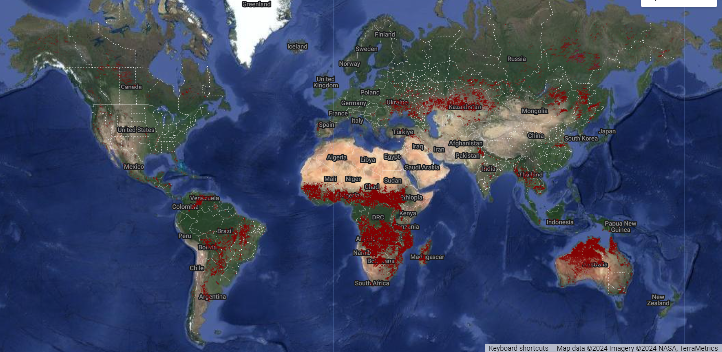
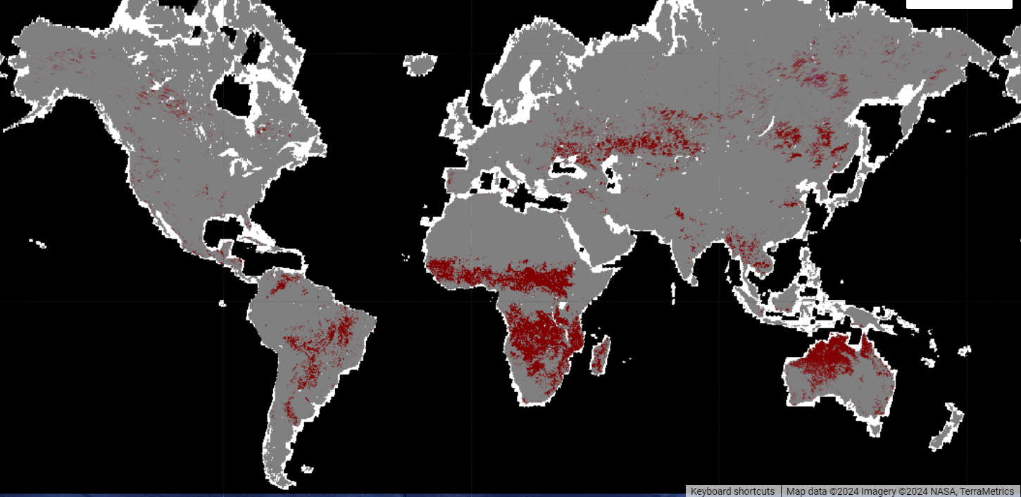
First Approach
1
Creation of Burn Mask from MODIS Data:
2
Creation of Land Data Mask:
- Temporal distribution of the analysis (13 years ):
start date (January 1, 2010)
end date (September 1, 2023)
- Derived from the ’BurnDate’ band of the MODIS dataset
- Identifies areas with at least one occurrence of burning.
- Extracting a land data mask from the Global Forest Change dataset .
- Filtering out irrelevant information and focusing the analysis on areas where wildfires might have occurred.

Slide 13
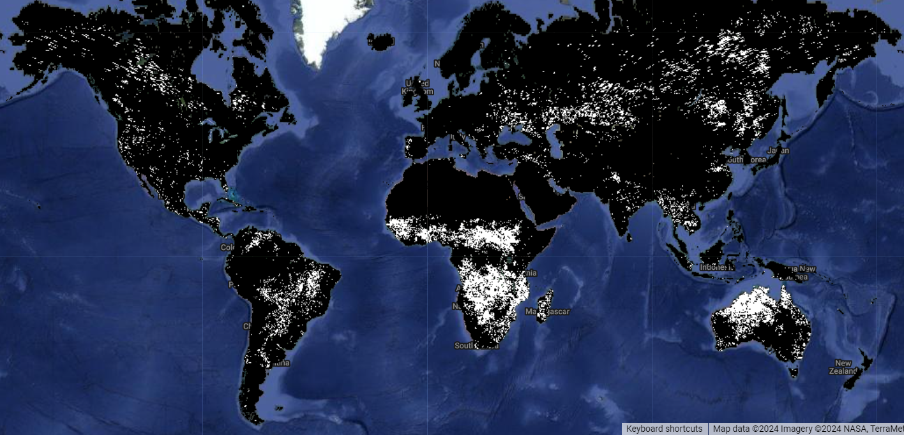
First Approach
3
Unmasking burned areas and creating Binary Mask
- The MODIS mask is applied to unmask burned areas, while setting non-burned areas to zero.
- The spatial resolution of the exported image has a scale of 50,000.
-CRS is specified as EPSG:4326.
- Opting for this scale aims to make the analysis faster and minimize computational demands.
Binary representation of burned and non-burned pixels:
White - Burned pixels
Black – Unburned pixels

Slide 14
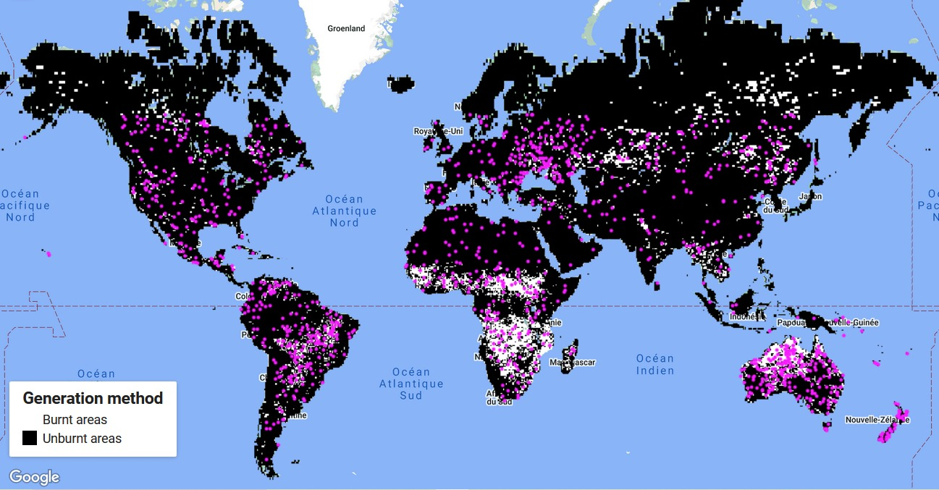
First Approach
4
Stratified Sampling
To distinguish which training points are going to belong to burned pixels and which to unburned pixels.
Adding band "Burn" as a band of the predictor image and use it for stratification.
The points are sampled from the predictor image.
Predictor Image
Binary Mask
• The scale for sampling same as the one of the binary mask.
• Sampling 100 points for each class of the "Burn" band:
- 100 points on the burned pixels, with Burn value = 1 - 100 points on the unburned pixels, with Burn value = 0.

Slide 15
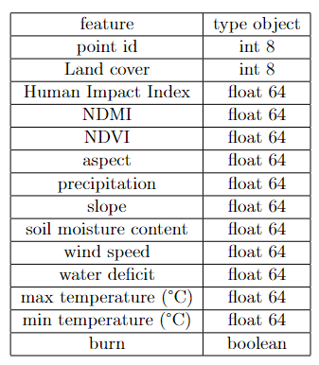

First Approach
5
Analysis of the dataset
Features of the Dataset
- In total 1251 points.
- Each point, represented by a row in the DataFrame, contains values for all the 14 features which are the columns of the DataFrame.
- Burn category (True) = 601 points.
- Unburned category (True) = 650 points.

Slide 16
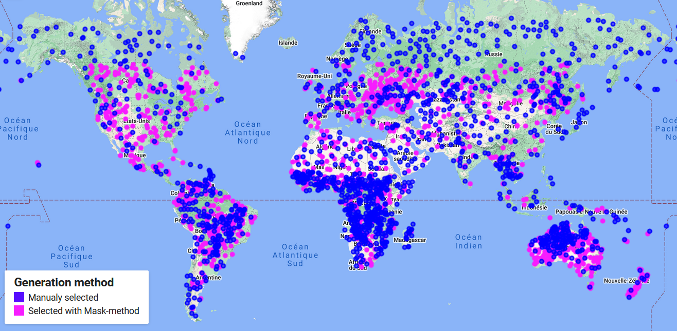
First Approach
Analysis of the dataset
5
( Random Forest Algorithm )
Datasets collected from GEE and used for the Random Forest Algorithm in Jupyter notebook

Slide 17
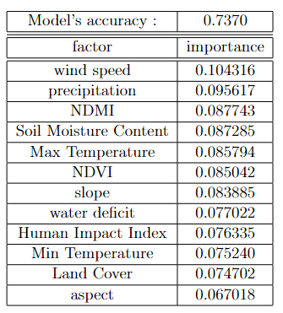
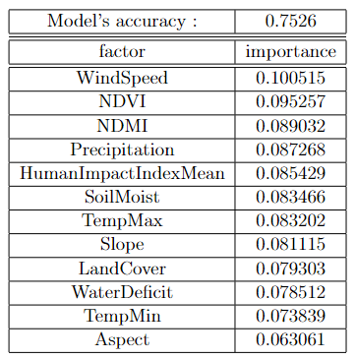
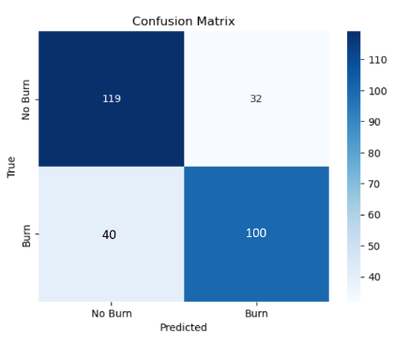
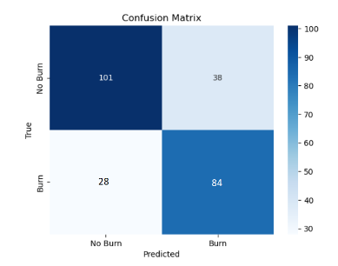
First Approach
Analysis of the dataset
5
( Random Forest Algorithm )
First dataset accuracy and feature importance
Second dataset accuracy and feature importance
- Feeding the model with only the points generated from stratified sampling.
- 80% training set vs 20% testing set
- Feeding the model with points taken manually from GEE.
Confusion matrix of first dataset
Confusion matrix of second dataset

Slide 18
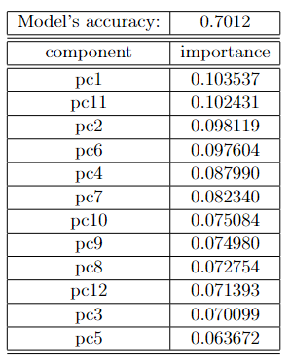
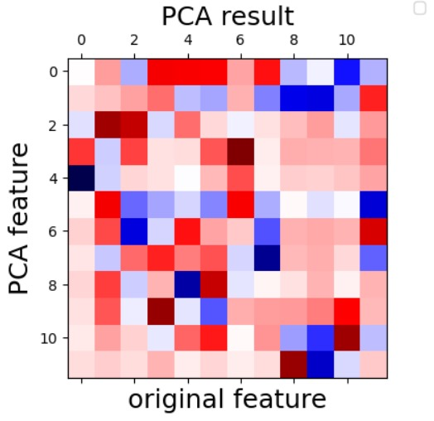
First Approach
6
Analysis of the dataset
(Principal Component Analysis (PCA) )
- The accuracy of the model decreased and no improvement was observed.

Slide 19
Second Approach
Filter MODIS by start and end date
Burn date threshold = 1
Classifying the pixels
Cumulative burned area image
Binary mask per each image
Pure Fires binary mask
Cumulative burned area image
1
Pure fires binary mask:
Reprojected and resampled to a 15km scale.
Values >= 1 are retained.
Values < 1 are masked out.
With a burn date > = 1 marked as burned and a value of 1 is assigned to them.
The rest are marked as not burned and a value of 0 is assigned.

Slide 20
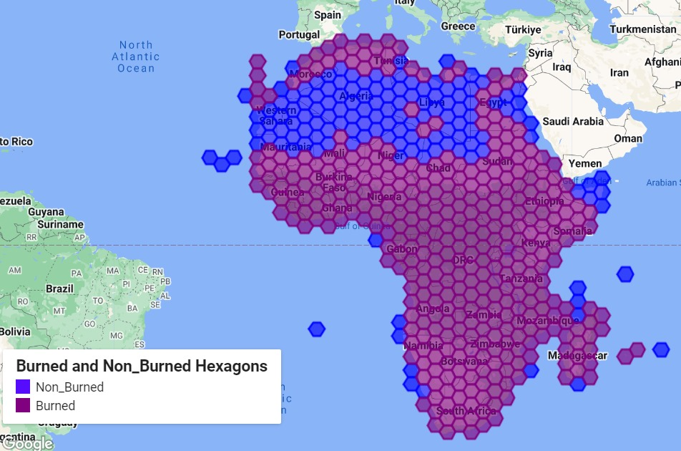
Second Approach
2
Dividing the hexagons of the grid:
Map Hexagon Grid
Africa Example
- The hexagons for each continent are divided into:
hexagons with burned pixel sum not 0.
hexagons with burned pixel sum 0.
Reduced to an image with a band called ‘unburned’.

Slide 21
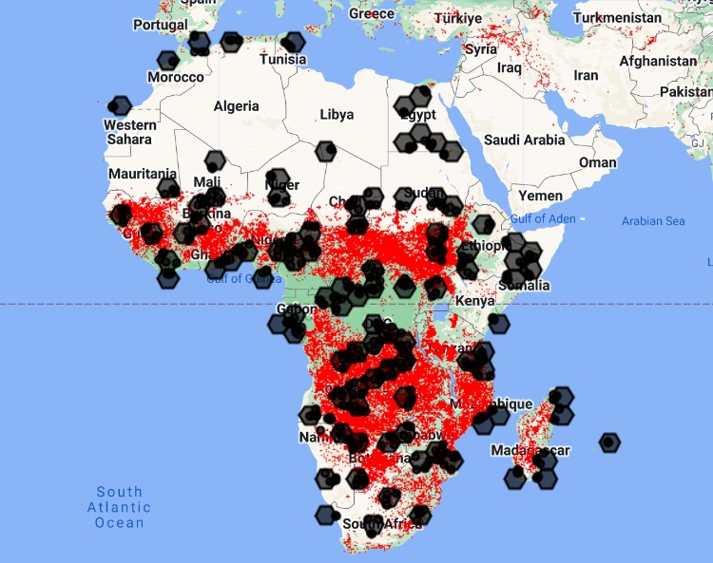
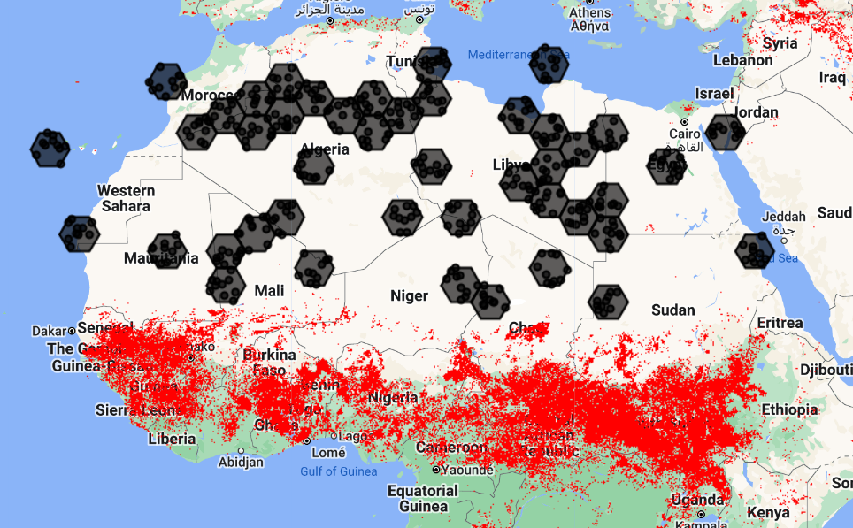
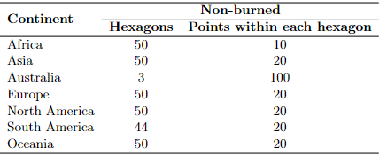
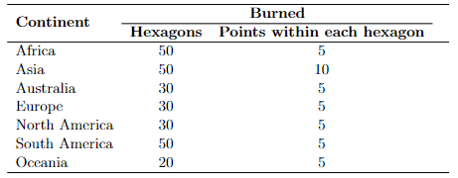
Second Approach
3
Sampling Points into hexagons and creating Feature Collections:
Sampling points in hexagons with burn sum not 0.
Sampling points in hexagons with burn sum 0.
Hexagon and Burned point distribution by continent
Hexagon and UnBurned point distribution by continent

Slide 22
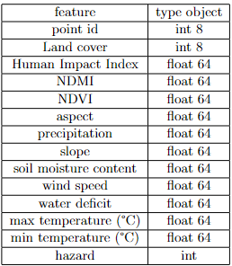
Second Approach
4
Analysis of dataset:
Splitting the dataset in training and testing sets
Cross- validation method : Stratified K Fold with 30 folds.
Chosen models for the analysis:
Metrics Calculation for each model:
Features of the Dataset
Training set : 80%
Testing set: 20%
Random Forest
Decision Tree
Bagging Tree
Extremely Randomized Tree
Ada Boost
Cross- validation accuracy
Test accuracy
Precision
Recall
F1 score
Confusion Matrix
burned points if int = 1 unburned points, if int = 0

Slide 23
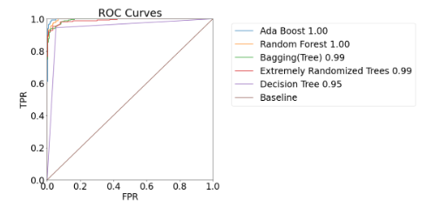
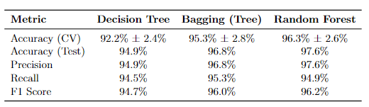
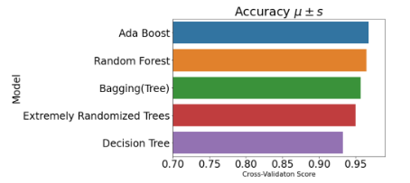
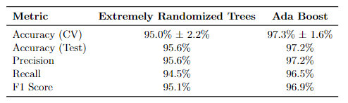
Graphical representation, that shows the trade-off between:
- the True Positive Rate (TPR) and
- the False Positive Rate (FPR).
Classification metrics for:
Decision Tree
Bagging Tree
Random Forest
Receiver Operating Characteristic curve and Area Under Curve
Each bar represents the mean accuracy obtained during cross-validation.
Quick assessment of the performance of each model in predicting wildfires based on the listed features.
Classification metrics for:
Extremely Randomized Trees
Ada Boost
Visual comparison of cross- validation accuracy scores for different classification methods.

Slide 24
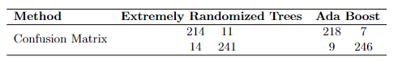
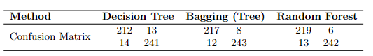
Second Approach
4
Analysis of dataset:
Confusion matrix for:
Extremely Randomized Trees
Ada Boost
Confusion matrix for:
Decision Tree
Bagging Tree
Random Forest
T test used to compare the classifiers’ performance:

Slide 25
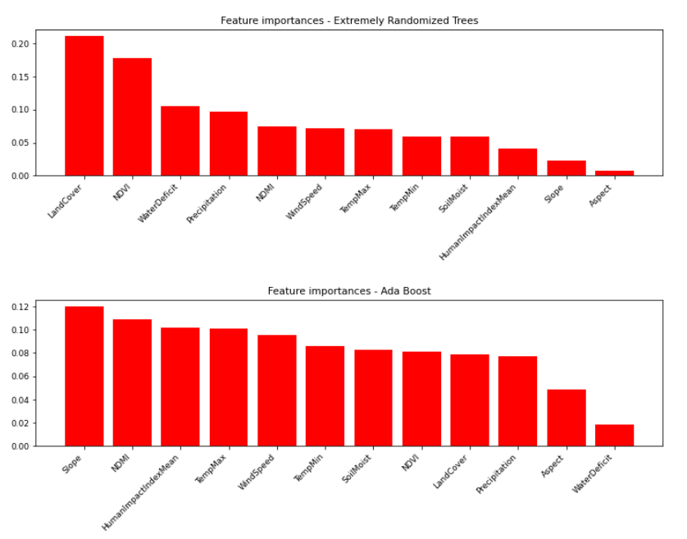
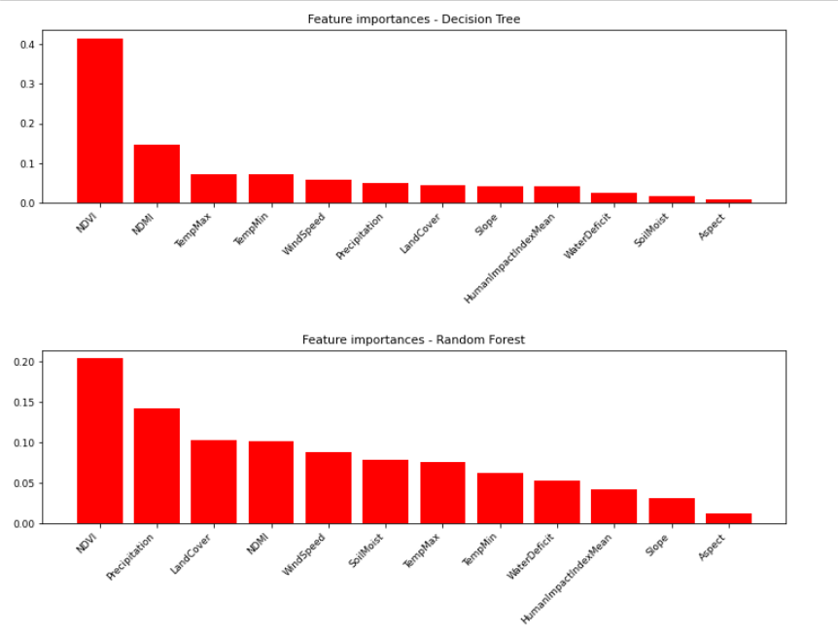
Second Approach
4
Analysis of dataset:
Feature importance plot of Decision Tree and Random Forest
Feature importance plot of Extremely Randomized Trees and Ada Boost

Slide 26


Conclusions
Two different methods were developed to create random points on the burnt and non-burned area.
These two methods both have their advantages
During the process of work there where several difficulties.
Random forest was the classifier giving the best performances among all the classifiers we trained.
Further analysis of the result could show that all the factors that were considered in the analysis have an impact on the prediction of fires, each of them in a different scale of importance.
Further developments may be applied to contribute in:
The refinement of classification models,
Temporal analysis
Spatial resolutions
Incorporation of additional factors
Integration with Real-Time data
Climate Change Impacts

Slide 27
Thank you for your attention!
Worked by:
Abbes Madeleine: Madeleinesarah.abbes@mail.polimi.it
Rajabi Forough: Forough.rajabi @mail.polimi.it
Zallemi Nikolina: nikolina.zallemi@mail.polimi.it

